Slide 1

Lee Algorithm

Slide 2

Lee Algorithm?
The Lee algorithm is one possible solution for maze routing problems.
It always gives an optimal solution, if one exists, but is slow and requires large memory for dense layout.
Maze Routing
Problem?

Slide 3

Maze Routing algorithm:
The Maze Routing algorithm is an algorithm to find connections between the terminals and the Lee algorithm is one possible solution for Maze routing problems.
Lee algorithm searches for the shortest path between two terminals and guarantees to find a route between two points if the connection exists.

Slide 4

Lee Algorithm:
Simple and easy solutions for maze routing problem.
Slow but can find the shortest path.
Require large memory for dense layout.
Gives optimal solution.
Based on breadth-first search.

Slide 5
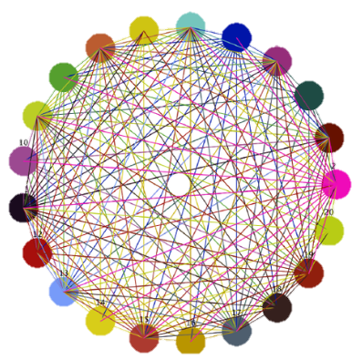

Lee Algorithm:
Require large memory for dense layout
Slow

Slide 6

Example:
People are connected in a network and performing different activities.

Slide 7
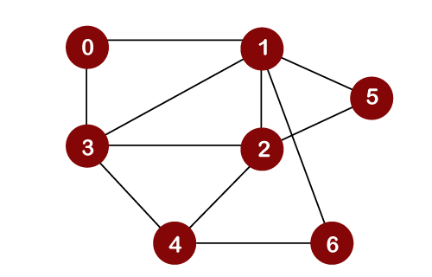
How it works?
The algorithm is a breadth-first based algorithm that uses queues to store the steps.
It usually uses the following steps:
Choose a starting point and add it to the queue.
Add the valid neighboring cells to the queue.
Remove the position you are on from the queue and continue to the next element.
Repeat steps 2 and 3 until the queue is empty.

Slide 8

How it works?
Ahmed wants to visit his friend ali’s house!!

Slide 9


How it works?
But Ahmed does not know the address of his house?

Slide 10

How it works?
After that he entered the society and chose a house and started asking people about his friend Ali and then by asking other neighbours he reached his friend's house.

Slide 11
Working:
Destination
Ali’s House!
Source
Starting point!

Slide 12
How did he find it?
1
 |  |  |  | D
 |  |  | S
Insert 1 in Queue..
Starting Point!

Slide 13
How did he find it?
1 | 2
 |  |  |  | D
 |  |  | S/1
Move to next positon and Insert 2 in Queue..
Starting Point=1

Slide 14
How did he find it?
1 | 2
 |  |  |  | D
 |  |  | 2
 |  | 2 | S/1 | 2
 |  |  | 2
Valid neighboring cells of 1

Slide 15
How did he find it?
1 | 2 | 3
 |  |  |  | D
 |  |  | 2
 |  | 2 | S/1 | 2
 |  |  | 2
Move to next positon and Insert 3 in Queue..

Slide 16
How did he find it?
1 | 2 | 3
 |  |  | 3 | D
 |  | 3 | 2 | 3
 | 3 | 2 | S/1 | 2 | 3
 |  | 3 | 2 | 3
 |  |  | 3
Valid neighboring cells of 2

Slide 17
How did he find it?
1 | 2 | 3 | 4
 |  |  | 3 | D
 |  | 3 | 2 | 3
 | 3 | 2 | S/1 | 2 | 3
 |  | 3 | 2 | 3
 |  |  | 3
Move to next positon and Insert 4 in Queue..

Slide 18
How did he find it?
1 | 2 | 3 | 4
 |  |  | 4
 |  | 4 | 3 | D/4
 | 4 | 3 | 2 | 3 | 4
4 | 3 | 2 | S/1 | 2 | 3 | 4
 | 4 | 3 | 2 | 3 | 4
 |  | 4 | 3 | 4
 |  |  | 4
Valid neighboring cells of 3

Slide 19

How did he find it?
Finally reached at destination…!
 |  |  | 4
 |  | 4 | 3 | D/4
 | 4 | 3 | 2 | 3 | 4
4 | 3 | 2 | S/1 | 2 | 3 | 4
 | 4 | 3 | 2 | 3 | 4
 |  | 4 | 3 | 4
 |  |  | 4
We find the shortest complete path in maze..

Slide 20

COMPLEXITY ANALYSIS
Time and space complexity for a m*n grid is O(m*n) which is size of the grid.
All this process leads to a O(MxN) time complexity where M and N are the dimensions of the matrix.
Also, since we require an additional MxN matrix to store the visited status of cells, the space complexity is also O(MxN).

Slide 21
Pseudo Code:
The pseudo code for Lee's algorithm is:
Set up the grid.
Create a 2-dimension array for the grid.
Select start point and assign it the value 1.
Select a destination.
Place any obstructions to the path.
Use wave expansion to move outwards from the start position until the goal is found.
Get the current node which will be initialized to the start position.
Assign all unlabeled neighbors of the current node with the value of their distance from the start.
Repeat this until the goal has been reached start or it is discovered that there is no path.
Back trace from the goal to the start.
Get the current node which will be initialized to the goal position.
Fine the neighboring node with a value less than that of the current node.
Add this node to path.

Slide 22
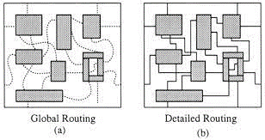
Applications:
Global Routing And Detailed Routing:
Global routing first partitions the
routing region into tiles and decides
tile-to-tile paths for all nets,
whereas detailed routing determines
the exact tracks and vias for nets.

